Slide 2
Romans 6:15-23

Slide 3

SLAVE
Uncleanness and Lawlessness
Righteousness and Holiness
Slaves of SIN or of GOD

Slide 4
What Do You Expect To Receive?

Slide 5

SIN DEFINED
ἁμαρτiα - hamartia
“To miss the mark…”
“to err, be mistaken, to miss or wander from the path of uprightness and honor, to do or go wrong, to wander from the law of God…”
Lawlessness – Transgression of Law – 1 John 3:4
1 John 5:17 “All unrighteousness is sin…”
Hebrews 10:26,27 “if we sin willfully…. No longer a sacrifice for sins…”
Acts 5:1-11; 1 Corinthians 11:30; James 4:17

Slide 6
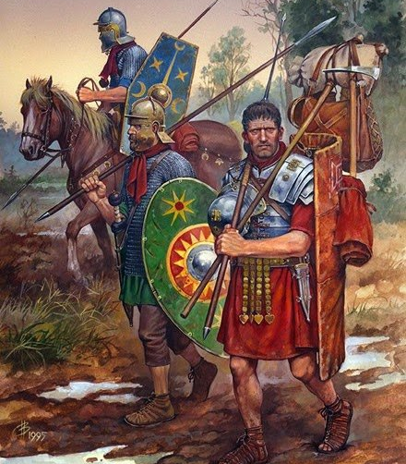
WAGES OF SIN
ὀψώνιον- opsōnion
“a soldiers pay or hire for someone to do some job”
Luke 3:14 “content with your wages”
2 Corinthians 11:8 “taking wages”
Death – Acts 17:28
Sin separates us – Isaiah 59:1,2
Romans 5:12
Revelation 21:8

Slide 7
FREE GIFT OF GOD
Titus 2:11,12 “grace of God that brings salvation has appeared to all men…”
“Free gift” is UNMERITED – so also is GRACE
LIFE – Genesis Chapter 1
Is this the “eternal life” Paul spoke of?
NO!
LIFE which is ETERNAL – not life as we know it without end!
1 John 2:25 “He has promised us- eternal life.”
John 10:10; 17:3 “this is eternal life…”

Slide 8
WHERE CAN THIS BE FOUND?
Only IN CHRIST! John 1:4 “In Him was life…”
John 11:25 “I am the resurrection and the life…”
1 John 5:12 “He who has the Son has life…”
Ephesians 1:22,23 “God put all things under Christ’s feet, and gave Christ to be head over all things to the church, which is Christ’s body, the fullness of God who fills all in all.”
To be IN CHRIST is to be IN HIS BODY, which is the CHURCH!
That is where those who have LIFE are found today

Slide 9
HOW MAY WE RECEIVE THIS GIFT?
“You are eligible for a FREE GIFT!”
Do you have to do anything to get it? YES!
Will you EARN IT? NO!
Galatians 3:26,27 “all sons of God through faith in Christ Jesus…..as many of you as were baptized into Christ have put on Christ.”
BELIEF that leads to BAPTISM = sons of God
John 15:10 “If you keep My commandments”
Revelation 2:10b; 3:1-6

Slide 10
WHAT CAN YOU EXPECT TO RECEIVE IN THAT GREAT, LAST DAY OF RECKONING?
WAGES OR GIFT?
ONLY TWO CHOICES!
WE WILL ALL RECEIVE ONE OR THE OTHER!

